Slide 1
PIZZA ORDRING WEB-APP
PEAZA

Slide 2
Introduction
Online Pizza ordering system is a web-based application that enables customers to order their pizzas online for home delivery or pick up from the pizzeria.
As the internet users are increasing exponentially, these companies have introduced an Online Pizza ordering system for taking orders from customers.
This system not only improves customer’s experience but also eases the workload on the staff of pizzerias.

Slide 3
Why an Online system for Pizza ordering was needed?
Online Ordering System:
Eliminates miscommunication associated with phone orders.
Provides a visual menu for a hassle-free selection process.
Efficiency Improvement:
Reduces overall purchasing time for customers.
Allows customers to place orders in advance through a mobile/web app.
Convenience Enhancement:
improving overall convenience of customers for smooth ordering.
Competitive Advantage:
Incorporating internet technology provides a competitive edge in the market.
Contributes to improved and efficient services for the pizzeria.

Slide 4
Objectives of Online Pizza Ordering System
Customized Pizza Selection: Facilitating customers to build their own pizzas, allowing them to choose specific ingredients according to their preferences. This customization feature aims to elevate the pizzeria's image and enhance overall customer satisfaction.
Order Confirmation and Details: Furnishing customers with comprehensive details of their order before finalizing the purchase. This confirmation step empowers customers to review selected items along with their respective prices, ensuring transparency in the ordering process.

Slide 5
Objectives of Online Pizza Ordering System
Paperwork Reduction: Minimizing the reliance on paper by transitioning various aspects of the ordering process to an online platform. This not only aligns with environmental considerations but also contributes to a more efficient and organized system.
Online Payment Option: Providing customers with the convenience of making cash-free transactions through online payment methods. This not only streamlines the pizza purchasing process but also aligns with modern payment preferences.
In summary, the online pizza ordering system aims to provide a tailored and efficient experience for customers while concurrently optimizing operational aspects for the pizzeria.

Slide 6
How this system works
Customer / Login Information:
Provides personal details - name, phone number and email.
Menu Display:
Menu with pizzas and other products displayed.
Ingredients listed with respective prices.
Pizza Customization:
Customer customizes the pizza, adjusting ingredients and selecting quantities.

Slide 7
How this system works
Payment Options:
Selects online payment method or cash-on-delivery.
Order Confirmation:
Order is placed, and customer receives notification.
This flow ensures a seamless and user-friendly experience for customers when ordering from the pizzeria's webpage or mobile application.

Slide 8
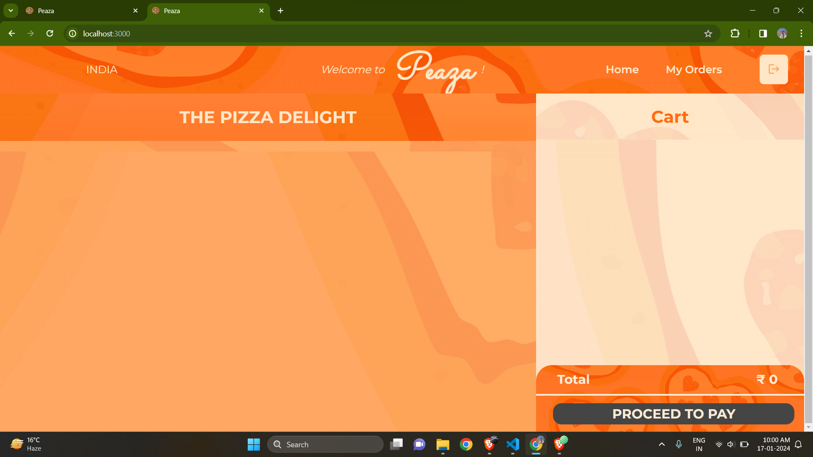
Abstract site layout
A basic website layout which is easy to Understand and Navigate for end user.

Slide 9
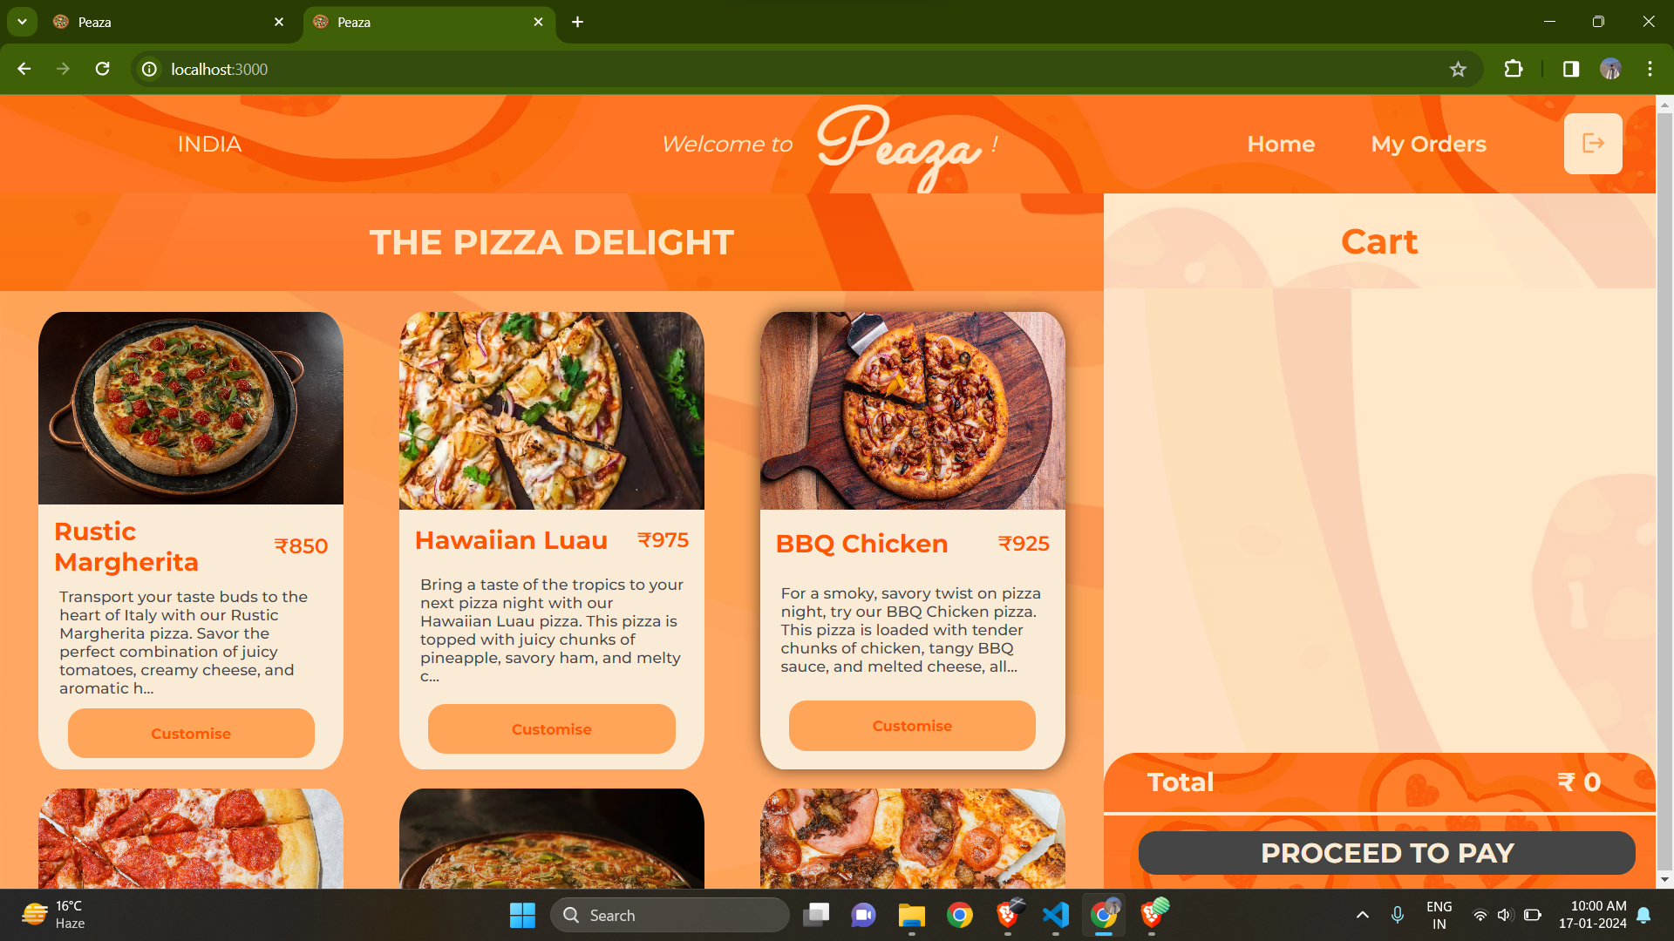
Menu layout
Menu with pizzas displayed with a tempting description of each pizzas with associated price.

Slide 10
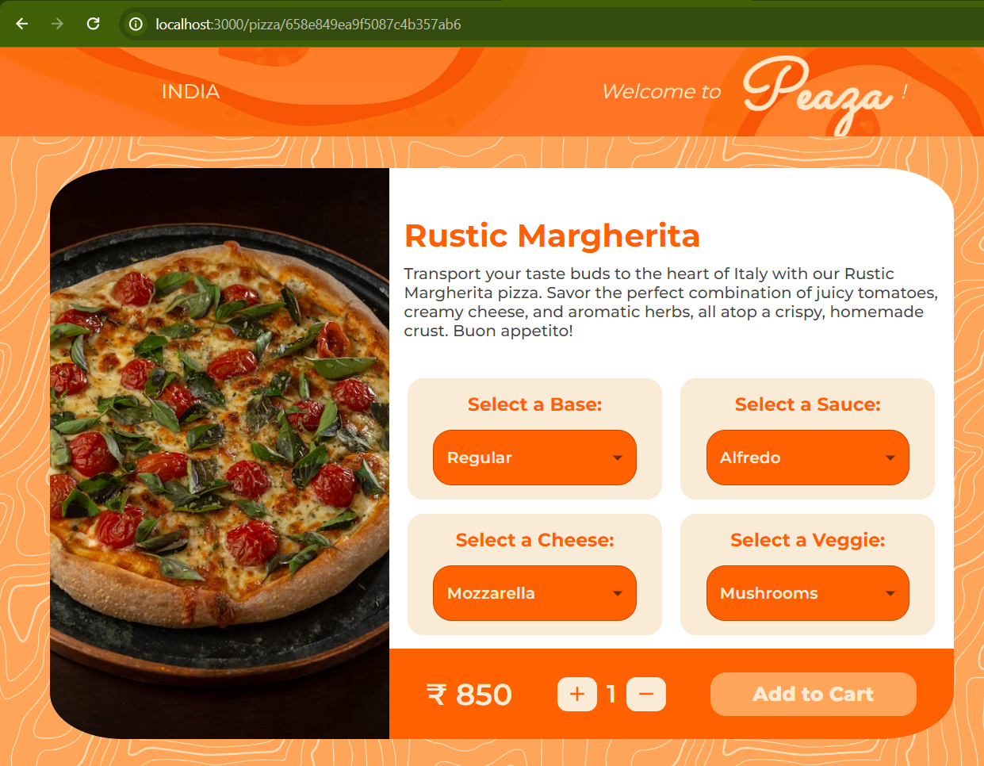
Pizza tab layout
An individual pizza with customization options such as base, sauces, cheese, and veggies.

Slide 11
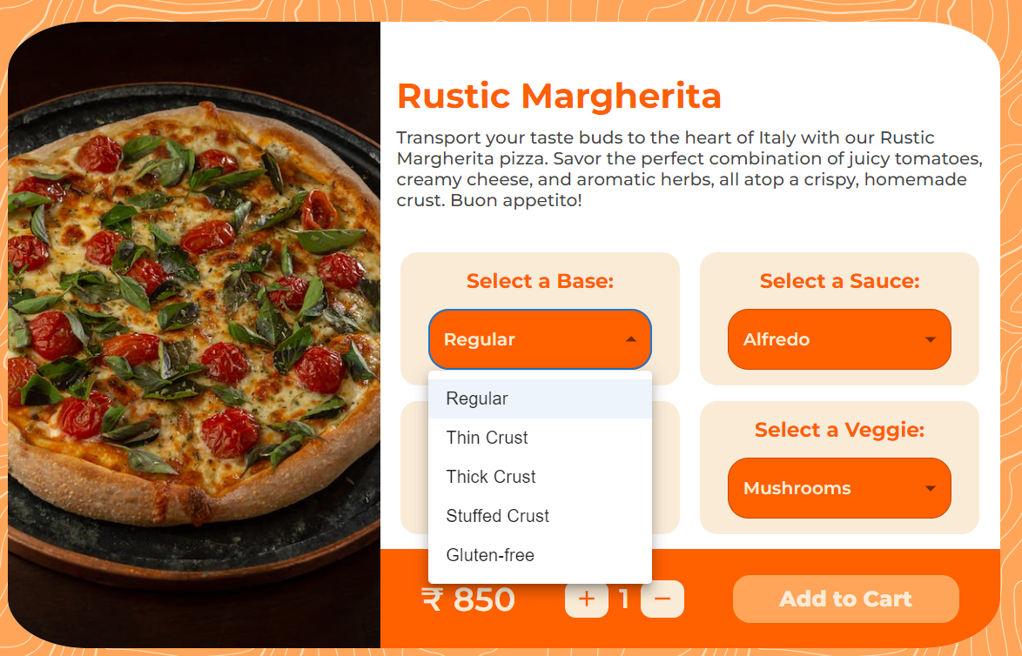
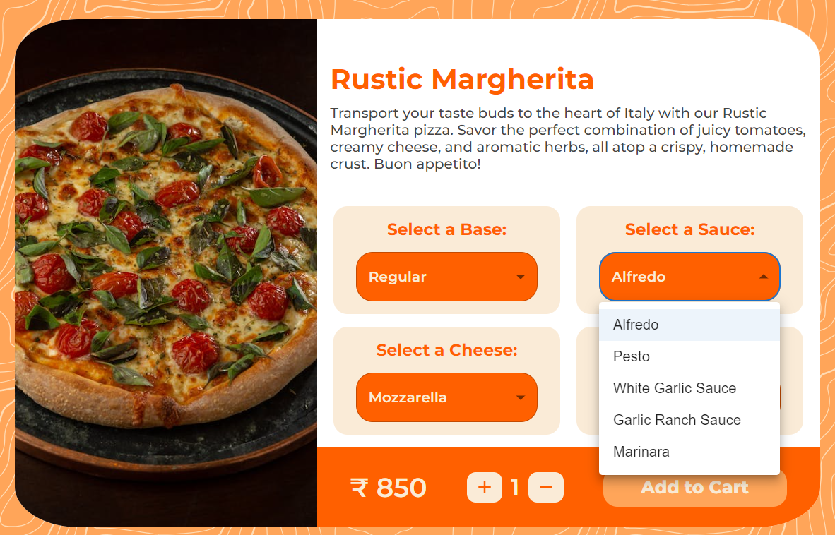
Customization Page
Here, we have added different types of Base and Sauce. One can choose according to their choice.

Slide 12
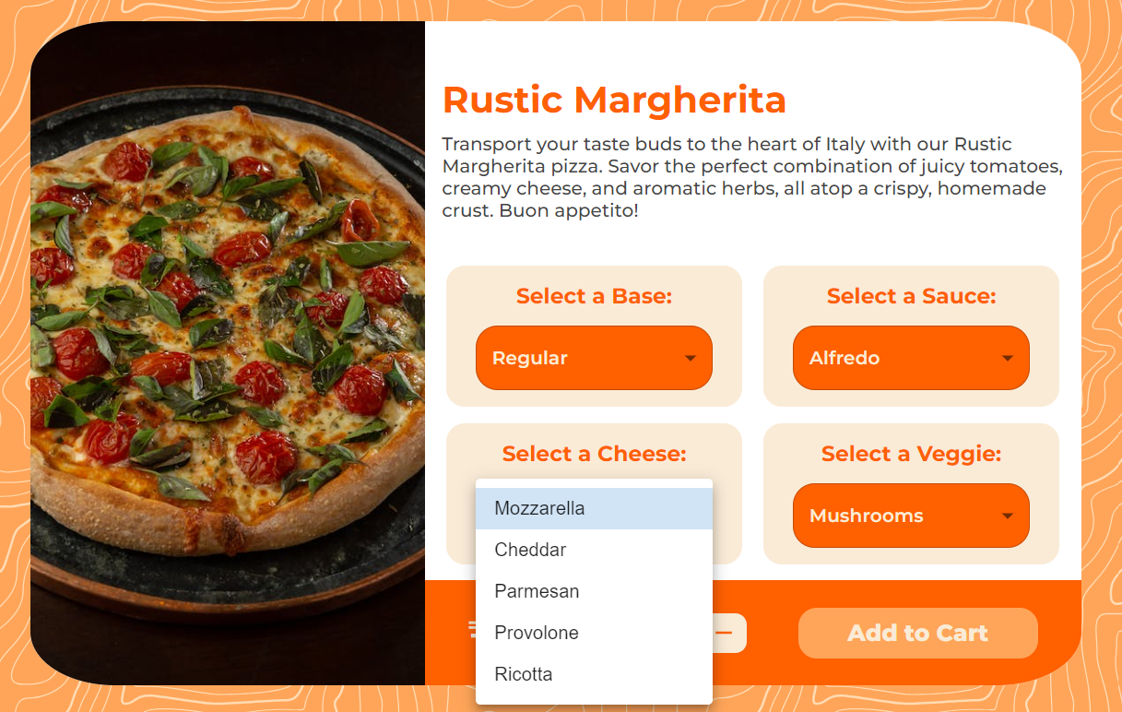
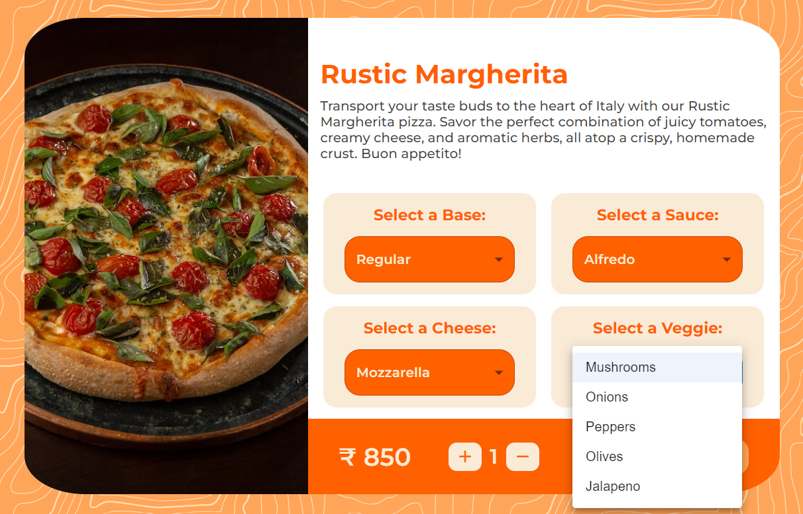
Customization Page
We have also included many kinds of Cheese and Veggie. One is free to make their own decisions.

Slide 13
Our Team
Krish Patel
Kaksh Patel
Devarsh Patel
IU2041050078
IU2041050077
IU2041050074

